Slide 1
A formative assignment on interpretation of scientific journal articles
Donald Winslow, Ph.D.
Indiana Academy for Science, Mathematics, and Humanities

Slide 2
Helping students read and interpret articles
Focused on scientific journal articles
In the fields of forest ecology and forestry
(for an AP Environmental Science class)
Questions posed to help students learn where to find specific info
Social information
Content information
Helping students determine what kind of paper it is
Primary research article
Meta-analysis
Literature review

Slide 3
Forest ecology journal articles (examples)
Baker, William L.; Chad T. Hanson; Mark A. Williams; and Dominick A. Dellasala. 2023. Countering omitted evidence of variable forests and fire regimes in western USA dry forests: The low-severity-fire model rejected. Fire 6:146, https://doi.org/10.3390/fire6040146.
Birdsey, Richard; Andrea Castanho; Richard Houghton; and Kathleen Savage 2023. Middle-aged forests in the Eastern U.S. have significant climate mitigation potential. Forest Ecology and Management 548:121373, https://doi.org/10.1016/j.foreco.2023.121373.
Ding, Wei-Dan; Ahmed Koubaa; and Abdelkader Chaala. 2013. Mechanical properties of MMA-hardened hybrid poplar wood. Industrial Crops and Projects 46:304-310, https://doi.org/10.1016/j.indcrop.2013.02.004.
Donovan, Victoria M.; Raelene Crandall; Jennifer Fill; and Carissa L. Wonka. 2023. Increasing large wildfire in the eastern United States. Geophysical Research Letters 50(24):e2023GL107051, https://doi.org/10.1029/2023GL107051.

Slide 4
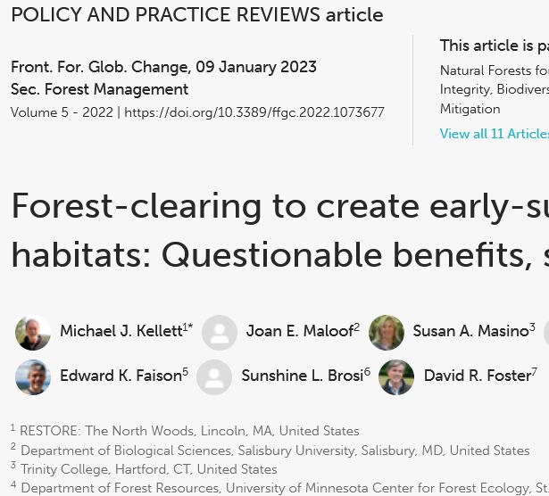
Types of information in journal articles
Social information
Authors’ institutional affiliations
Funding sources
Content information
Study objectives
Hypotheses tested
Findings

Slide 5
A literature review
Law et al. 2022. Creating strategic reserves to protect forest carbon and reduce biodiversity
losses in the United States. Land 11:721, https://doi.org/10.3390/land11050721.
Abstract: This paper provides a review and comparison of strategies to increase forest carbon, and reduce species losses for climate change mitigation and adaptation in the United States. It compares forest management strategies and actions that are taking place or being proposed to reduce wildfire risk and to increase carbon storage with recent research findings. International agreements state that safeguarding biodiversity and ecosystems is fundamental to climate resilience with respect to climate change impacts on them, and their roles in adaptation and mitigation. The recent Intergovernmental Panel on Climate Change report on impacts, mitigation, and adaptation found, and member countries agreed, that maintaining the resilience of biodiversity and ecosystem services at a global scale is “fundamental” for climate mitigation and adaptation, and requires “effective and equitable conservation of approximately 30 to 50% of Earth’s land, freshwater and ocean areas, including current near-natural ecosystems.” Our key message is that many of the current and proposed forest management actions in the United States are not consistent with climate goals, and that preserving 30 to 50% of lands for their carbon, biodiversity and water is feasible, effective, and necessary for achieving them.

